Slide 1
ENGI 301 MusicBox Proposal
02/13/2023
Connor Kelly

Slide 2
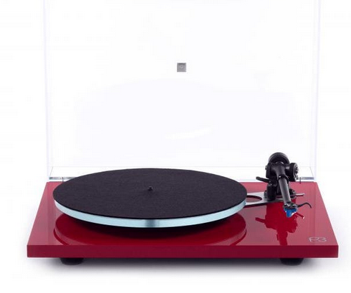
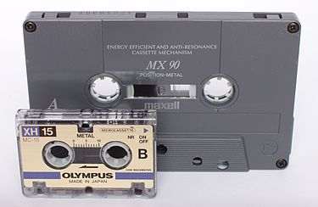
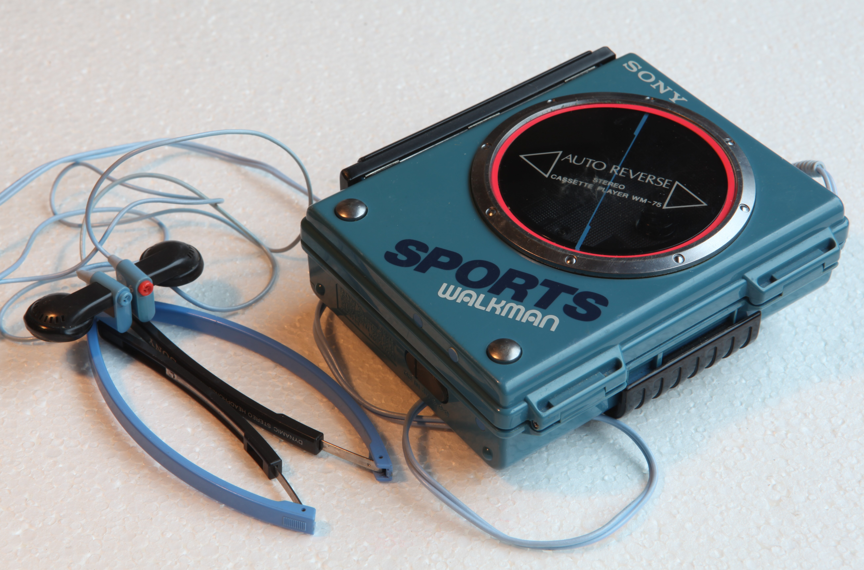
Background Information
When I got a record player and a small vinyl catalog as a present from my grandparents, I initially considered it a novelty, until I realized how much more I enjoyed the music coming from the player.
I found a certain magic in the fact that I can just press play. I’m so used to having my spotify playlist, and being able to pause or skip or queue, all from my phone. With the record player, those simply aren’t options, and I think this may be a contributing factor to my enjoyment.
So, my goal is to create something similar, yet modern: I plan to create simple USB "cartridge" based audio player.
Software: https://mopidy.com
Another Link: https://magpi.raspberrypi.com/articles/build-a-home-music-system-with-raspberry-pi

Slide 3
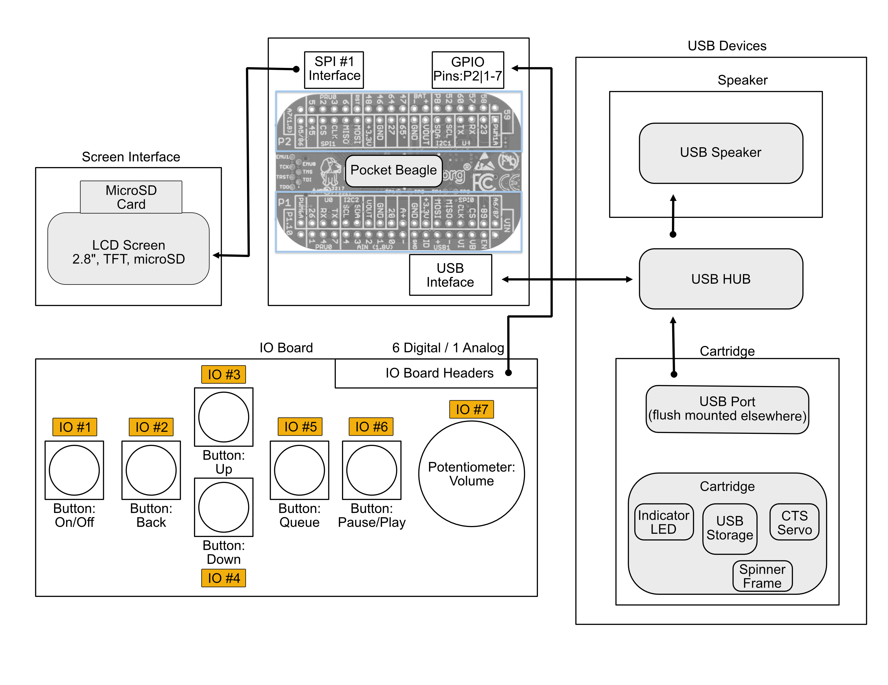
System Block Diagram

Slide 4
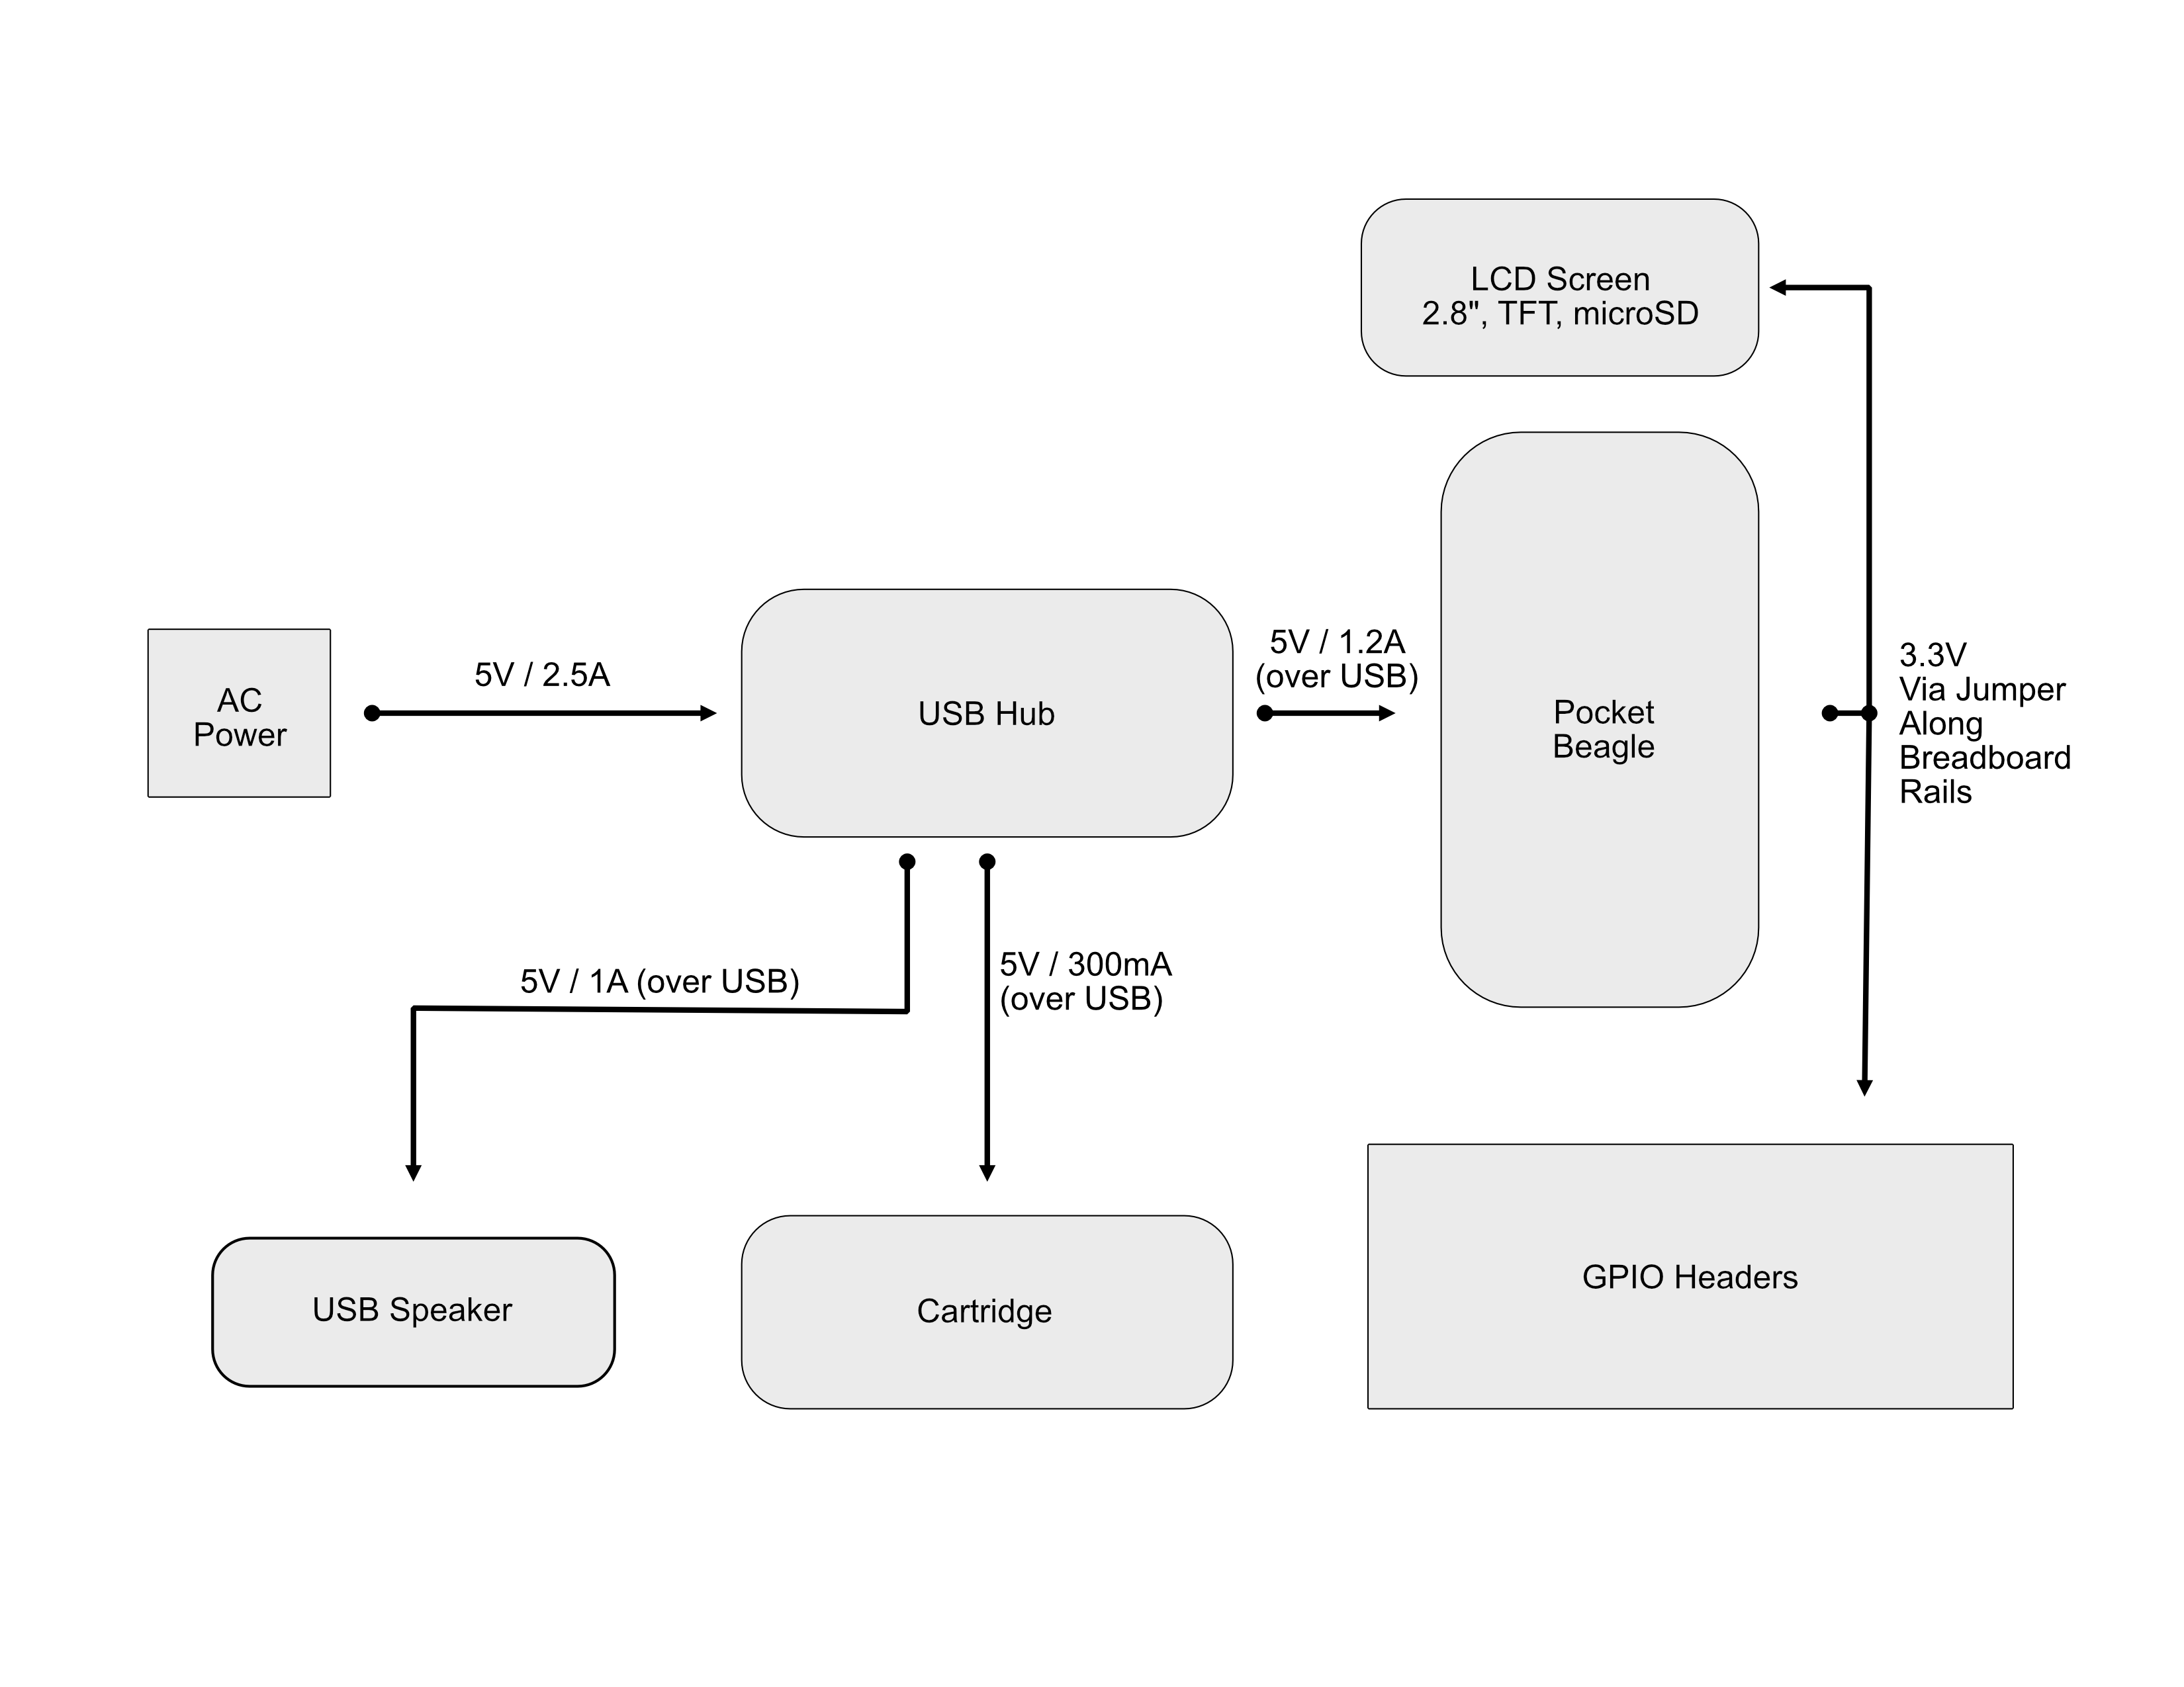
Power Block Diagram

Slide 5
Components / Budget
Component | Need to Buy | Cost
BeagleBoard PocketBeagle | No | ($47.50)
USB Hub | https://a.co/d/fYHrCPh | Yes | $19.99
USB Speaker | https://a.co/d/8OIqLUI | Yes | $13.58
LCD Screen 2.8” TFT | https://www.adafruit.com/product/1770 | Yes | $29.95
Buttons x 6 | https://www.adafruit.com/product/367 | No * | ($2.50) ($0.75)
Potentiometer (Flush Mount) | https://www.adafruit.com/product/562 | No * | ($0.95)
USB Flash Drive | https://a.co/d/8lfc9hB | No * | ($24.68) ($2.46)
LED | No | ($4.95) ($0.20)
Continuous Servo | https://a.co/d/6aKJO0a | Yes | ($26.99) $5.40
USB Breakout | https://a.co/d/d0jVBUZ | No | ($6.99) ($0.70)
Total |  | $71.32
No * : indicates items which don’t need to be bought, but may be included in a final/finished prototype
[price] : indicates the total price of a bulk item
(price) : indicates a quantity price which is excluded because it doesn’t need to be bought

Slide 6
Component Selection (Remove slide for submission)
All components must be from either: Amazon, Adafruit, Sparkfun, Digi-Key, or Mouser
Select no more than two (2) components that are not on approved component spreadsheet
See Canvas → Files → assignments → ENGI301_project_01_parts_list.xlsx
All components needed for the project should be listed on Slide 5
All components should have links to the website where they can be purchased
Please trim URLs for links to Amazon
All components together should not cost more than $75
If you have a special request, we can discuss in the project meeting

